Slide 1
Augmented Reality (and object recognition)
Channel Overview

Slide 2
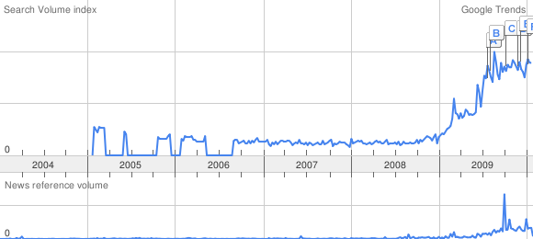
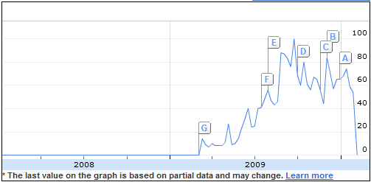
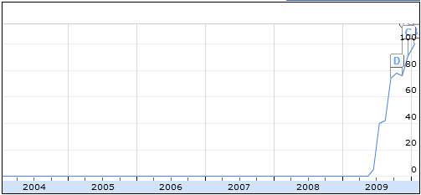
Channel Opportunity
AR’s Growth in popularity
Google Trends show searches and websites for augmented reality multiplied by 6x over the past year. All years before have shown no growth at all.
As network speeds and mobile device’s computing capabilities increase, more powerful AR applications are being released.
“Augmented Reality” search term trend
“Augmented Reality” News Interest
“Augmented Reality Apps” search term trend

Slide 3
Business Applications
Travel / Tourism
Publishing
Marketing & Advertising
Retail / Product Simulation
Education / Training
Entertainment
Smart Phones

Slide 4
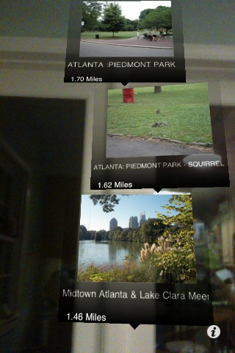
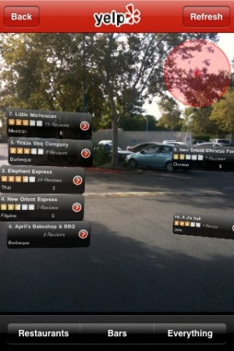
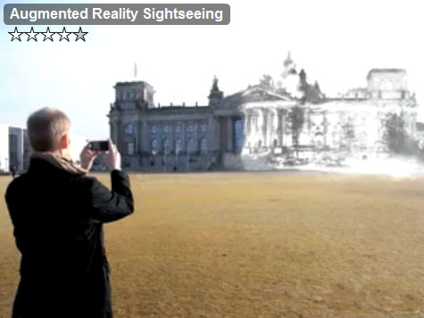
Travel / Tourism
What’s already out there?
Floating text and images
Very poor use of AR.
GPS devices have poor accuracy (+-100m)
There is no object recognition going on, purely based off of maps & GPS
Tour guide
Audio tour of what your looking at
Videos of relevant information
Images – Take a snapshot of building, and explore different eras of what the building looked like
PhotoAr
Yelp

Slide 5
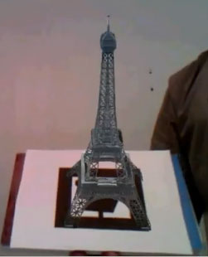
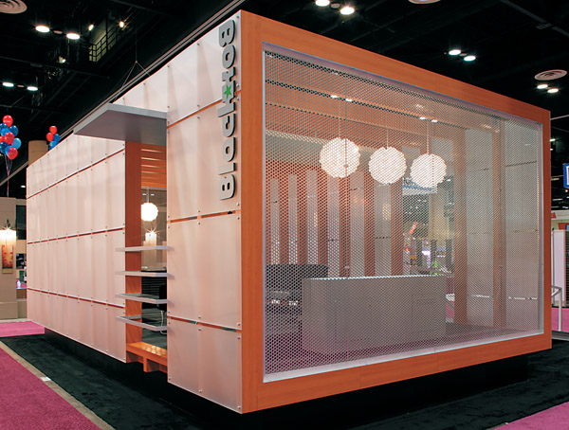
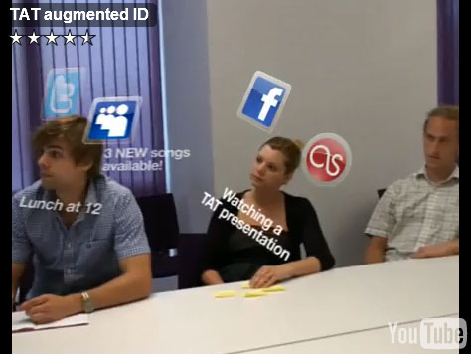
Travel / Tourism
What are some possibilities?
For tourist businesses, let your user print a marker and look closely at some of the site seeing they can do on your tour.
Look through buildings to see if there is any interest in going inside.
Augmented objects (person?) over landmarks to create fun pictures.
Object recognition can tell your friends where you are without texting or calling.
Meeting new people in strange places can be dangerous. Some apps already exist that do face recognition and show the person’s facebook, twitter…etc. Could be packaged with traveling applications.
Zoom into landmarks you can’t reach (or don’t want to).

Slide 6
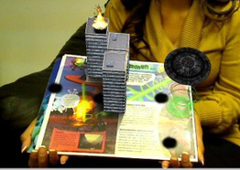

Publishing
What’s already out there?
Interactive videos & pop-ups in
Books
Magazines
Greeting cards

Slide 7
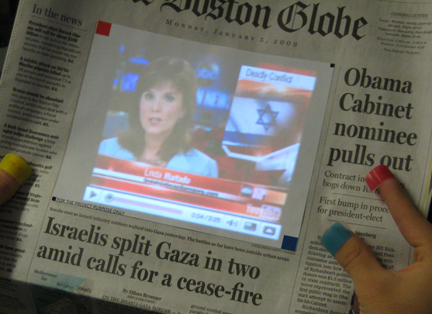
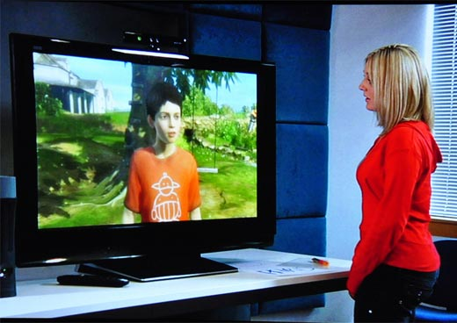
Publishing
What are some possibilities?
Replace 2d views on iPad or Kindle with a pair of (video) glasses that bring to life any newspaper, magazine, catalog, book or a presentation in 3d.
Characters that are augmented on prints can recognize your face.

Slide 8
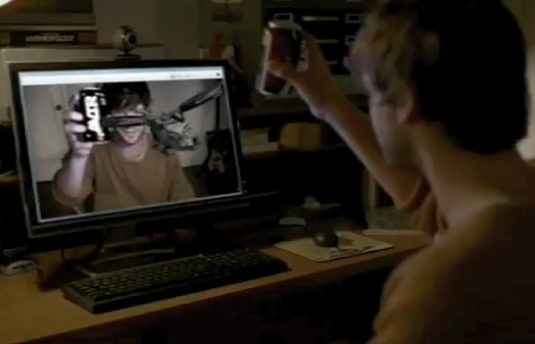
Marketing and Advertising
What’s already out there?
Augmented Reality is still a hype – draws a lot of attention
Purchased products advertise other products through markers printed on them
Coca-Cola & Avatar

Slide 9
Marketing and Advertising
What are the possibilities?
Audience can explore and interact with an ad
Create a deeper impression
Ads can recognize who / what their looking at
Adults and children can be presented with a different ad
“Funny” or “cool” ads can let users interact with them and share the video with friends causing more hype

Slide 10
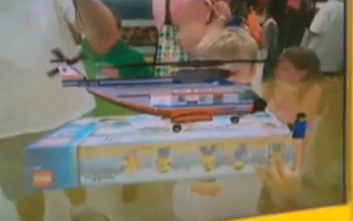
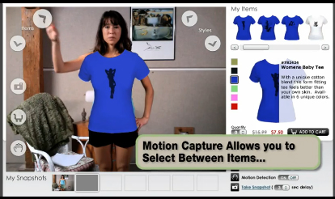
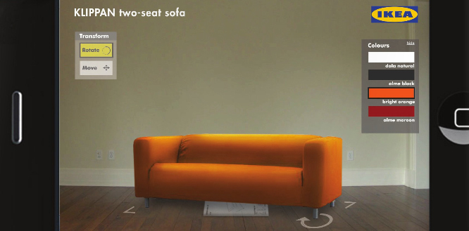
Retail / Product Simulation
What’s already out there?
See product from all sides
Customize product
Users can experience the product
Simulate how the product behaves or how the user interacts with it.
Wear the product: glasses, clothing, hair style.
Place the product in desired environment, e.g. Ikea furniture.
See Lego built before you buy
Try on clothing
Try on Ikea furniture

Slide 11
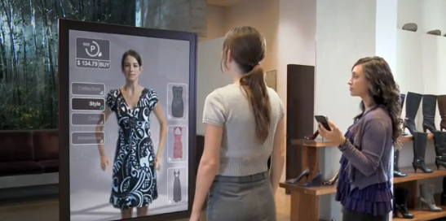
Retail / Product Simulation
What are the possibilities?
Better tracking for clothing on body (moving arms moves shirt)

Slide 12
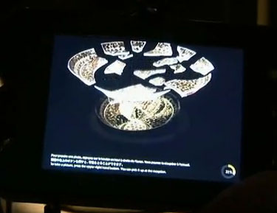
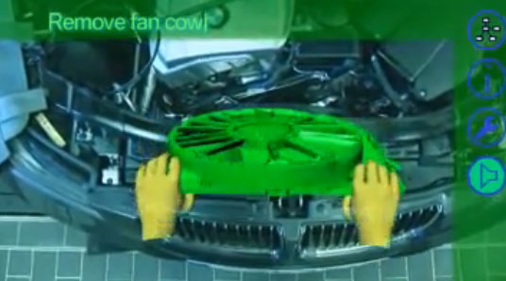
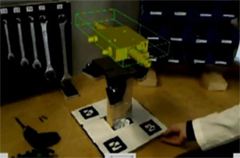
Education / Training
What’s already out there?
Explore museum or exhibitions with an AR guide to see the display alive.
Hands on assistance for training and repairs.

Slide 13
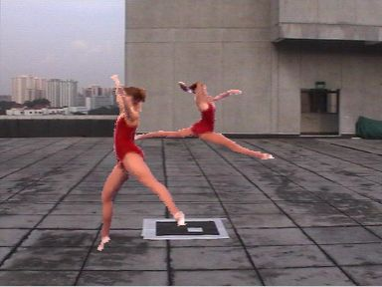
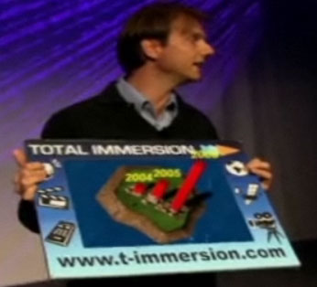
Education / Training
What are the possibilities?
Personal coaches
Enhanced visual presentations
AR Zoo – cages with markers

Slide 14
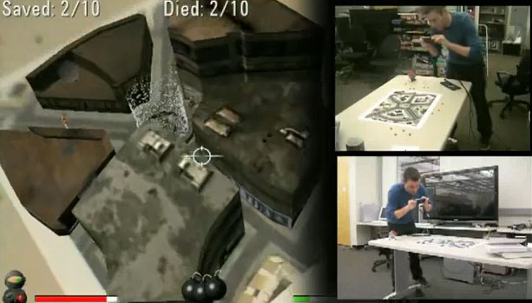
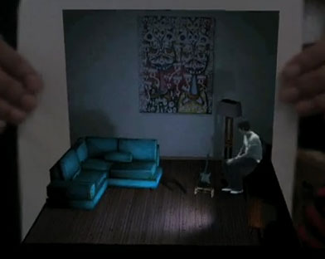
Entertainment
What’s already out there?
Music Videos
Gaming

Slide 15
Entertainment
What are the possibilities?
Multiplayer gaming
“Fly-through” movies

Slide 16
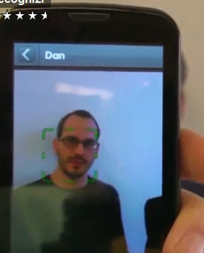
Smart Phones
What’s already out there?
Face Recognition – Identify stranger
Travel and tourism apps
Location based games

Slide 17
Major Technologies
Things BLITZ Knows
Flash Platform
On Website & Desktop
Marker Tracking
Face Recognition
Things BLITZ Doesn’t Know
C Platforms
AR Toolkit
OpenCV
Markerless Tracking.
Track any object.
LinceoVR
AR KIT for smartphones

Slide 18
Flash Platform
Positive
Open Source
Viewable online and offline
Cross Platform
No installation files required
Negative
No GPU acceleration
Performance is very limited
No Smartphone access yet, and when there is, it probably wont work well
No markerless tracking

Slide 19
C Platform – AR Toolkit / Open CV
Positive
Open Source
GPU acceleration
Performance is very good
Markerless tracking
Object recognition (Open CV)
Negative
Offline only

Slide 20
LinceoVR
Positive
Incredible tracking and 3d rendering quality
Markerless tracking
Negative
Not open source
Expensive

Slide 21
Thoughts?
Proprietary AR
Total Immersion has created markerless tracking on different platforms, with the research that is available free online, and a hire with a background in image processing, we can build our own proprietary software.

